Slide 1
Customer Churn Analysis
-Sakthi Devi S 24.10.2025

Slide 2
Project analysis slide 4
Project Overview
Handle missing values, encode categories, scale numbers.
Data Collection and Pre Processing
Identify churn patterns,
Understand key influencing factors,
Build a predictive model and
Visualize insights in a dashboard
Goal
EDA and Predictive Modelling
Find patterns and relationships with churn. Train models to predict churn.
Project Objectives
Implementation Plan
when a customer stops using a company’s service.
Predict and analyze customer churn to identify at-risk customers and improve retention.
End to End Workflow
Customer Churn
Build dashboard in Power BI using DAX formulas for business use.
Visualization and Insights

Slide 3
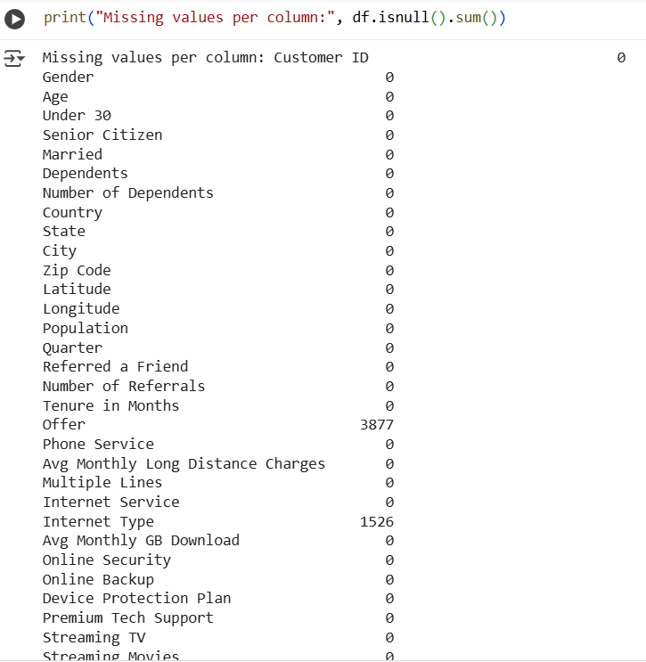
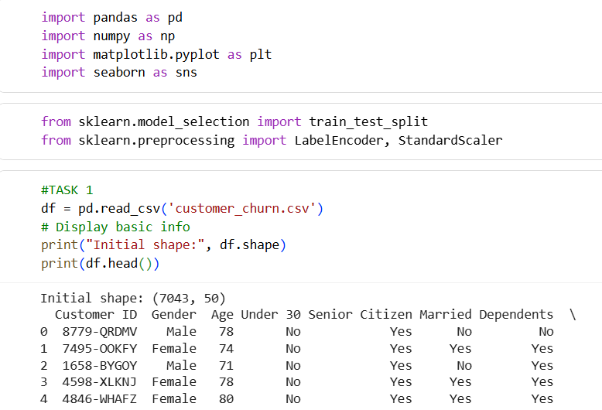
Project analysis slide 4
Data Cleaning &
Preparation
1.Load dataset and import Libraries:
pandas (pd) → for loading and manipulating data tables (DataFrames).
numpy (np) → for numerical operations (used implicitly by pandas).
LabelEncoder → converts categorical (text) columns into numeric binary columns.
StandardScaler → standardizes (scales) numeric columns so they have mean=0 and std=1
train_test_split → splits dataset into training and testing sets to evaluate models.
To check the missing values per column for cleaning the data.
Customer Churn

Slide 4
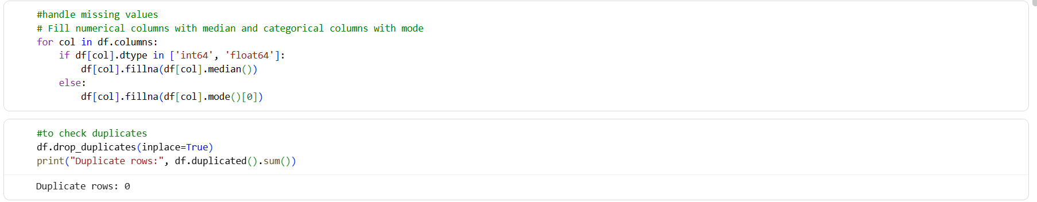
Project analysis slide 4
Data Cleaning &
Preparation
2.Handle Missing or inconsistent values:
If it’s numeric , missing values are replaced with MEDIAN
If it’s categorical(text) , missing values are replaced with MODE
Checking Duplicate Rows using inbuilt functions.

Slide 5
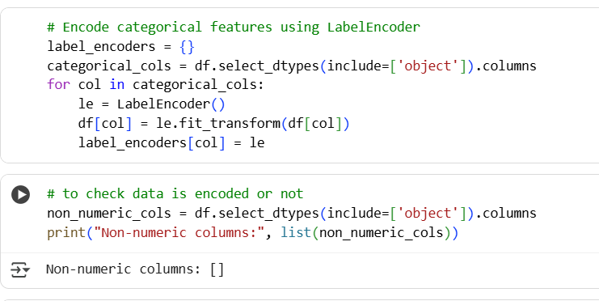
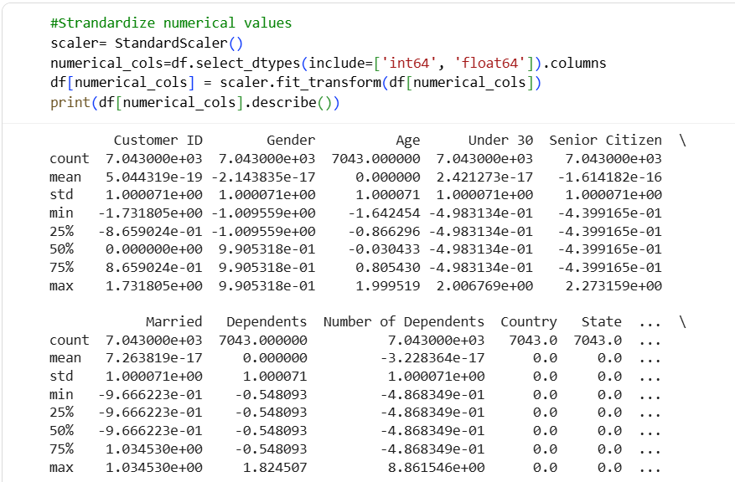
Project analysis slide 4
Data Cleaning &
Preparation
3.Encode categorical features:
4. Standardize numerical variables.
Converts text data into numbers for machine learning models by the following process.
Finds all categorical columns
Creates a new LabelEncoder for each column and replaces text with numbers.
Standardizes all numeric columns:
Each column’s mean → 0
Standard deviation → 1
So that all columns have similar range which is easier to train the models and predict
Project Objectives
Customer Churn

Slide 6
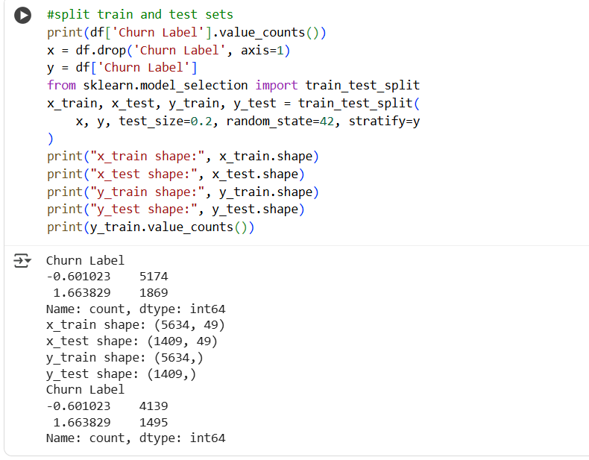
Project analysis slide 4
Data Cleaning &
Preparation
5.Split data into training and testing sets:
Train- the model learns pattern for the data and about 80% dataset is trained.
Test- To check performance on the data model has never seen and 20% data is split for test purpose

Slide 7
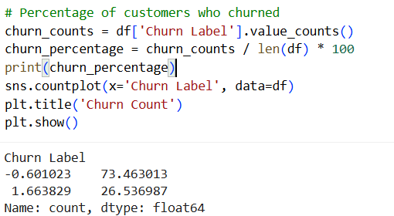
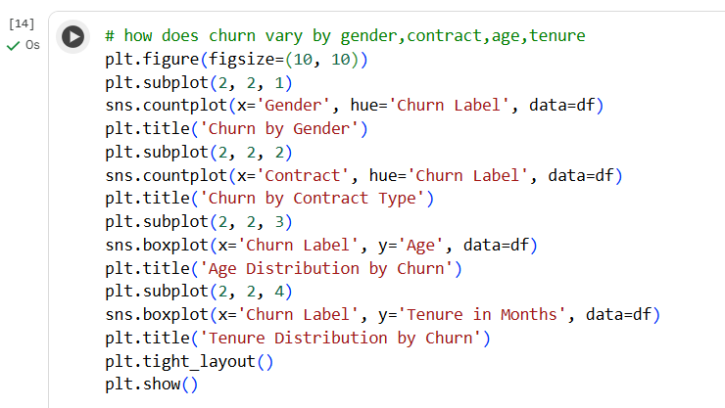
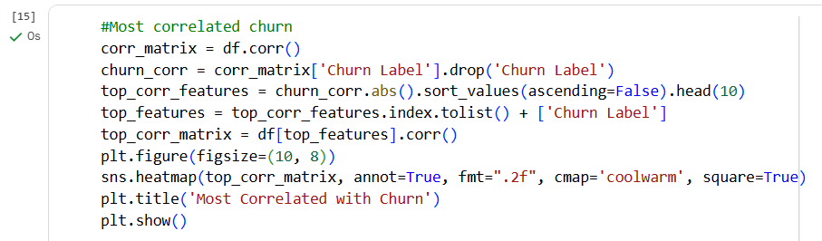
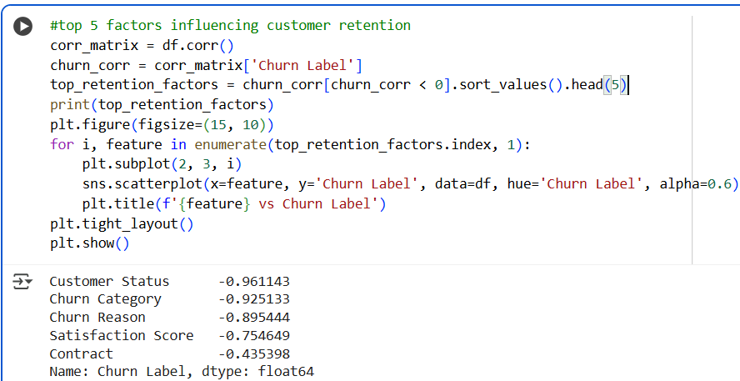
Project analysis slide 2
Exploratory Data
Analysis
Exploring dataset to understand it before building any model by understand data structure , check data quality and understand relationship is called EDA
What percentage of customers have churned?
How does churn vary by gender, age, contract type, or tenure?
What percentage of customers have churned?
Which features are most correlated with churn?
Top 5 factors influencing customer retention?

Slide 8
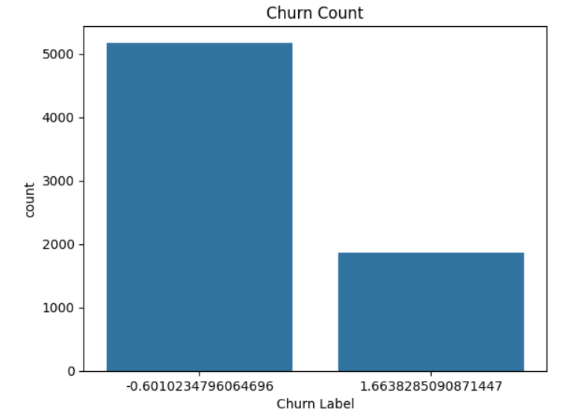
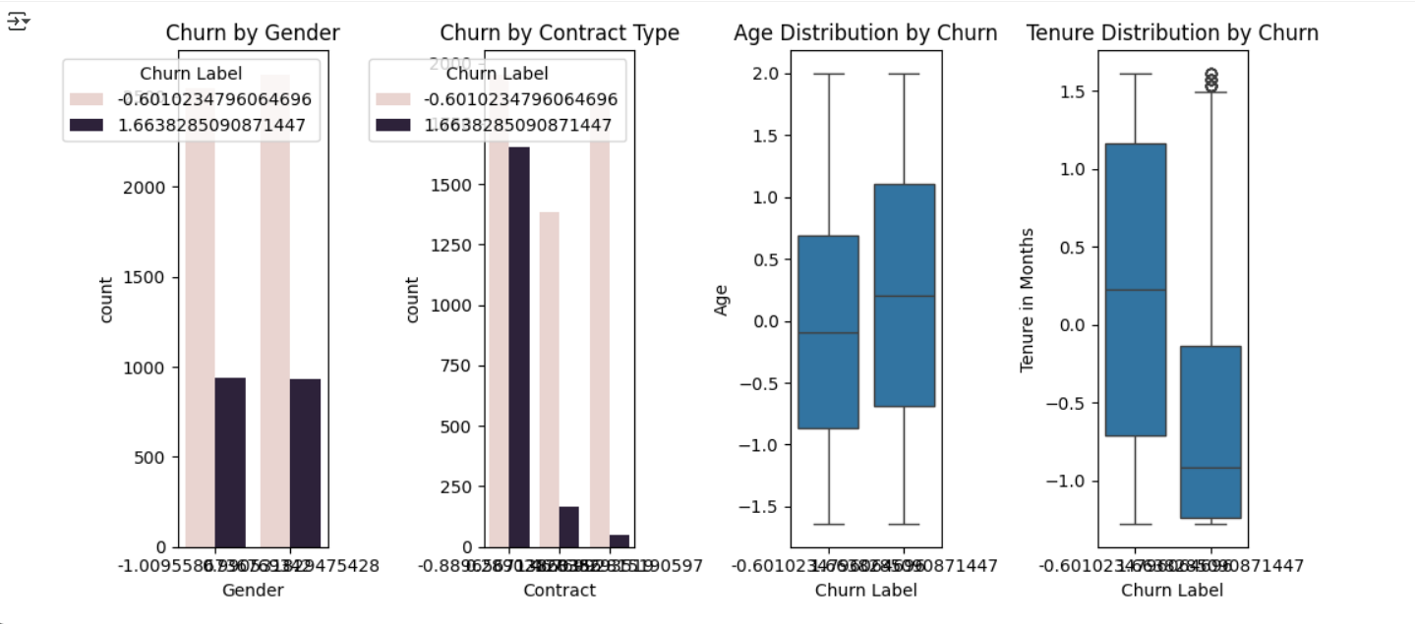
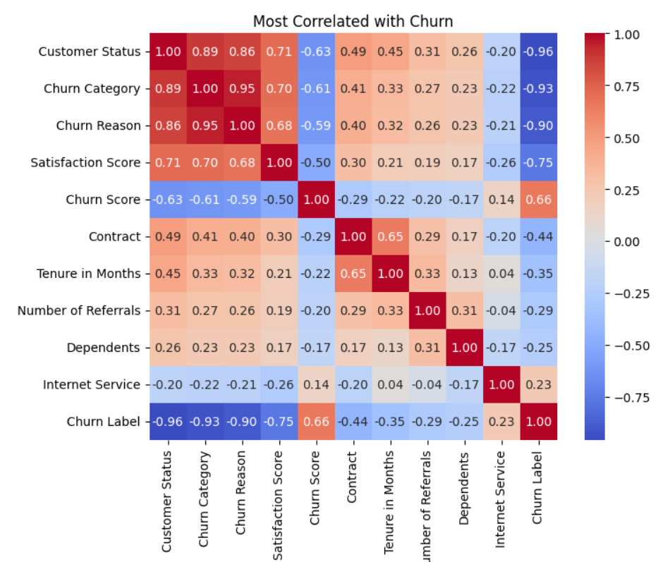
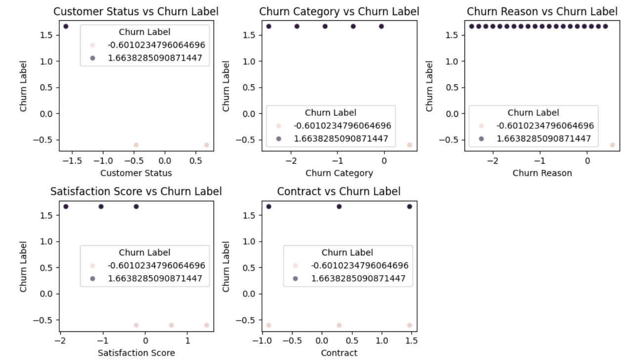
Project analysis slide 2
Exploratory Data
Analysis
Churn=1
No Churn=0

Slide 9
Project analysis slide 3
Predictive Modelling
What is Predictive Modelling?
Train Models
Evaluate Models
Visualize
Analysis
A model gives a probability that specific customer will churn next month so it can trigger an automated retention offer.
Logistic Regression
Decision Tree
Random Forest
Extreme Gradient Boost
Accuracy
Precision
Recall
F1-Score
Confusion Matrix
ROC Curve
AUC Curve
Compare and picks the best model for Predicting churn. Interpret model like feature importance

Slide 10
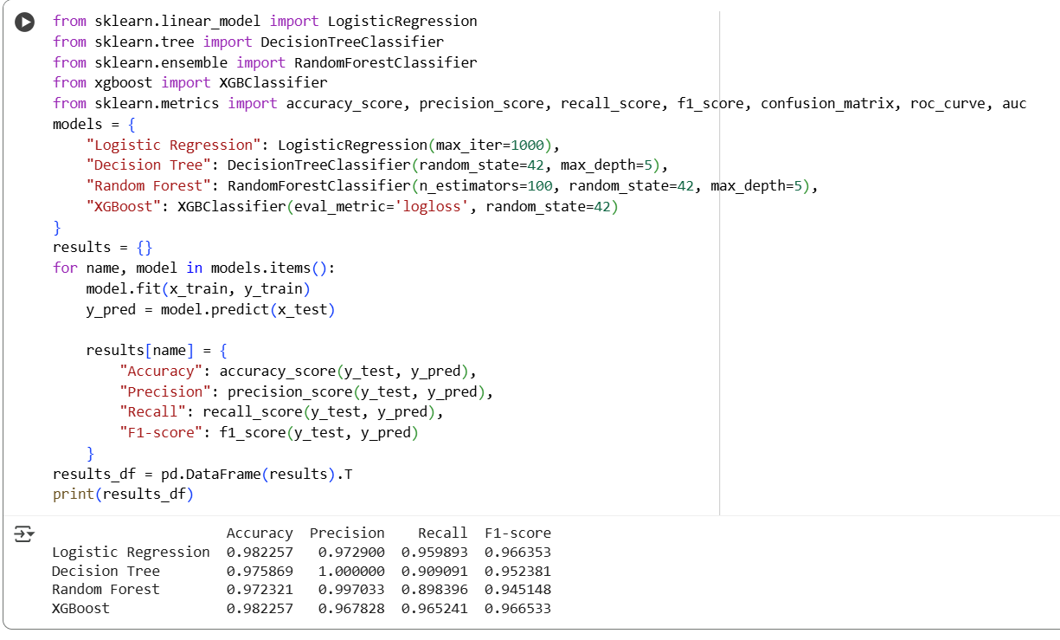
Project analysis slide 2
Predictive Modelling
Build and evaluate Logistic Regression, Decision Tree, Random Forest, or XGBoost model.
Compare model accuracy, precision, recall, and F1-score.
Confusion Matrix = 2x2 Table of True Positive(TP), True Negative(TN), False Positive(FP), False Negative(FN).
Accuracy=(TP+TN)/Total
Precision=TP/(TP+FP)
Recall(Sensitivity)=TP/(TP+FN)
F1-Score = Hormonic mean of Precision and Recall = (2*PR)/P+R
ROC Curve = Plot of TP Recall vs FP Recall for varying thresholds.
AUC Curve = Area under curve where 0.5 is random and 1.0 is perfect.

Slide 11
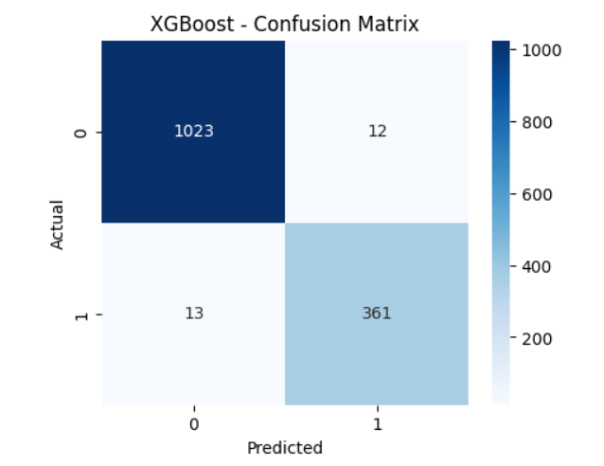
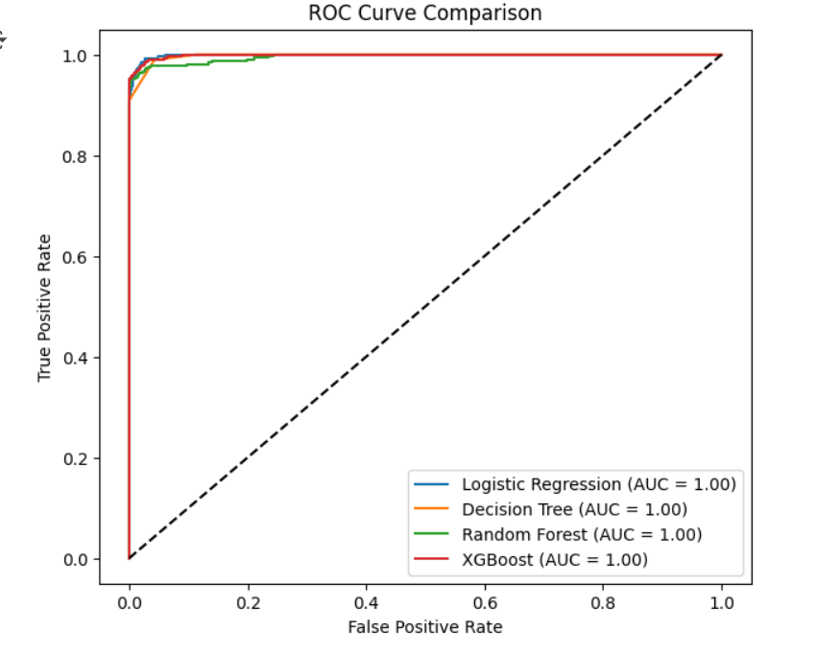
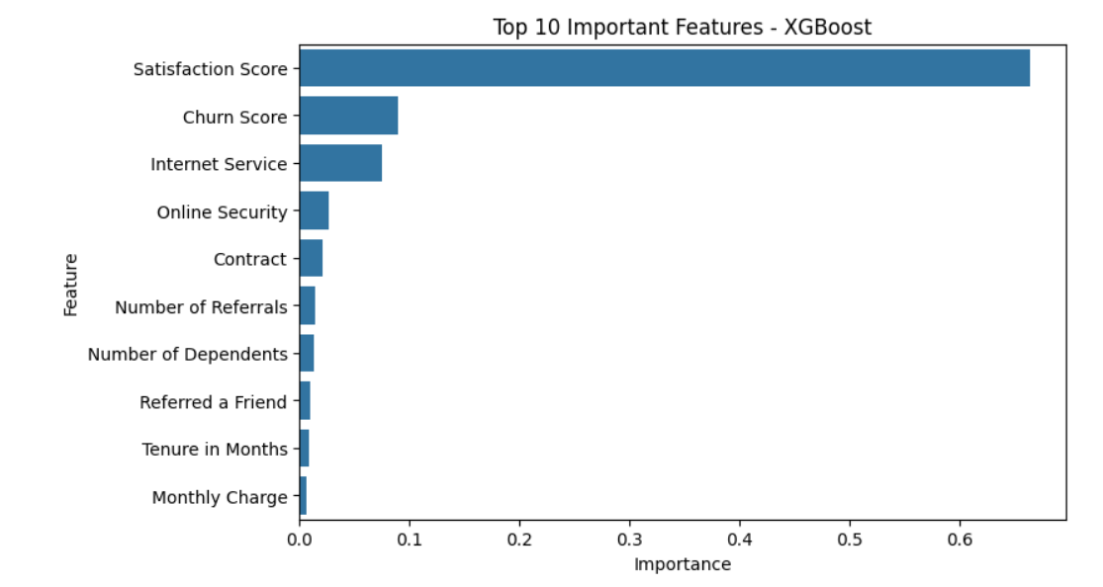
Project analysis slide 5
Predictive Modelling
Confusion Matrix
ROC & AUC Curve
Importance Features
TP=1023, TN=361, FP=13, FN=12
The model accurately predicts customers likely to churn.
AUC Value is 1.0 for all the models Which is Perfect. ROC curve shows the trade-off between recall and false positive rate.
Helps identify which factors (like tenure, contract type, etc.) influence churn the most.

Slide 12
Project analysis slide 6
Insights &
Business Recommendations
Loyalty Programs
Reward customers with high tenure or satisfaction.
Offer discounts, points, or early upgrades to at-risk segments..
Personalized Communication
Use insights from segments (age, location, usage pattern) to create relevant offers.
Send reminders or perks before contract renewal for high-risk customers.
Contract Incentives
Encourage long-term contracts for customers on month-to-month plans.
Offer flexible upgrade/downgrade options.
Product/Service Improvements
Address recurring churn reasons (e.g., network issues, billing confusion).
Launch feedback collection programs to continuously monitor dissatisfaction drivers.
Customers on month-to-month contracts might have a 43% churn rate vs 54% for 2-year contracts. Low satisfaction score is strongly linked to churn.
Targeted Customer Support
Proactively reach out to dissatisfied customers. Provide priority support or personalized solutions.

Slide 13
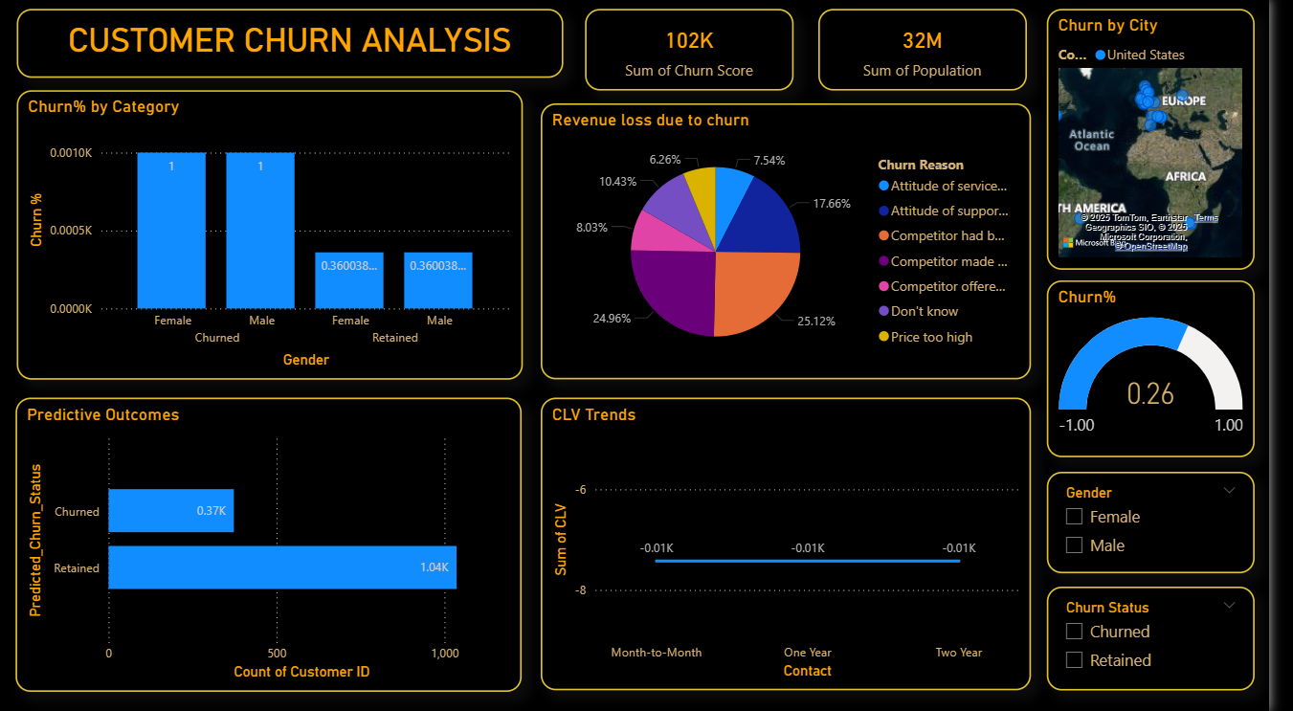
Project analysis slide 7
Dashboard
Churn% by Gender and churned category has high percentage in churned than retained.
Revenue loss due to churn has large summation percentage in competitor.
In Future or Predicted Outcomes only 0.37k were churned which is 30%.
Customer Lifetime Value(CLV) was almost equal in 2 years.
Europe has more Churn by Cities.

Slide 14
Thank You!!!

